Slide 1
Census Data Standardization & Analysis Pipeline
Leveraging Streamlit and Python for Comprehensive Data Analysis

Slide 2
Project Overview
Aim to analyze census data for insights on demographics, households, and socio-economic conditions.
Utilize Python and Streamlit for data processing, visualization, and interaction.
Primary Goals:
Fetch and standardize census data.
Load data into MongoDB and Oracle databases.
Provide interactive analysis through a Streamlit application.
Answer specific socio-economic questions based on census data.

Slide 3
Technologies Used
Programming Language:
Python
Libraries and Tools:
Pandas, cx_Oracle, MongoDB, Oracle DB, Streamlit

Slide 4
Data Fetching and Standardization
Fetching Data:
Process to fetch census data and load it into a DataFrame.
Data Standardization Steps:
Formatting state names.
Renaming columns for consistency.
Handling null values and filling missing data.

Slide 5
Loading Data into Databases
MongoDB:
Load standardized data into MongoDB for NoSQL operations.
Oracle DB:
Create 3 RDBMS tables (District , Demographics, Household) and load data.
Extract data from Oracle tables into DataFrames for further analysis.

Slide 6
Streamlit Application
Session State Initialization:
Maintaining data state across different user actions.
Sidebar Actions:
Buttons for fetching data, standardizing, and loading into databases.
Analysis questions selection and execution.

Slide 7
Data Analysis Questions
Examples of Analysis Questions:
Total population of each district.
Literate males and females in each district.
Household access to cooking fuel, internet, and other facilities.
Religious composition and educational attainment distribution.

Slide 8
Visualization and Results
Streamlit Display:
Interactive dataframes showing analysis results.
Header sections for different analysis categories (e.g., District wise data, Demographics, Household).

Slide 9
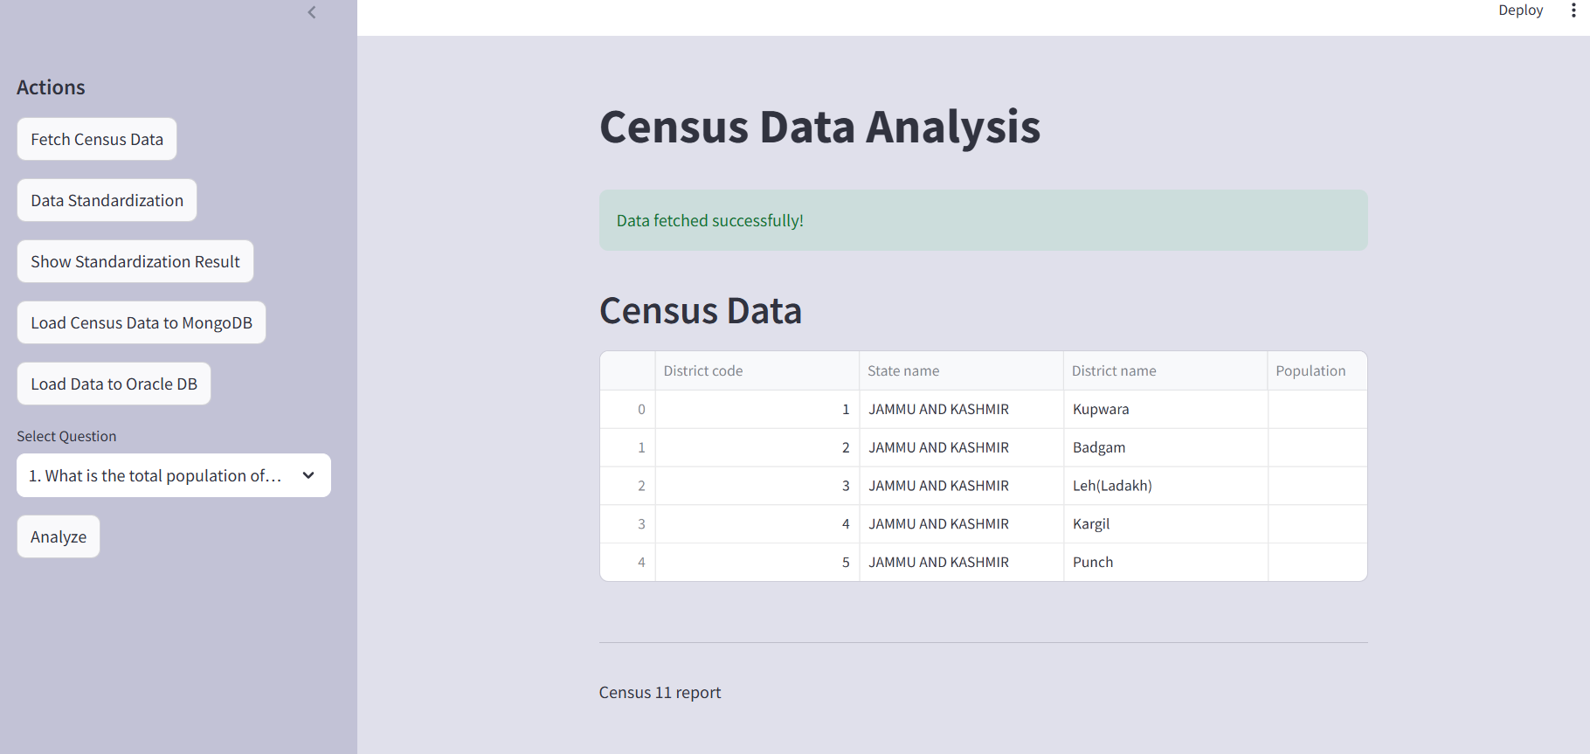
Streamlit Application View

Slide 10
Project Code Repository
Access the full project code and documentation on GitHub.
Follow the link below to explore the codebase, detailed explanations, and additional resources.
GitHub Repository

Slide 11
Conclusion
Summary:
Achieved comprehensive analysis of Census data.
Provided valuable insights into demographic and socio-economic trends.
Successfully demonstrated the use of Streamlit for interactive data applications.

